Slide 1
Classes and Objects
Documented Code
Minified Code

Slide 2
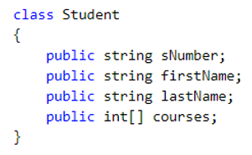
Define Class
Classes
Are complex (non-primitive) custom data types
Can be used to declare variables of the custom type
Allows the creation of new objects (class instances)
Variables contain a reference to an object location
Is used as needed (if you have objects of its type)
Define the structure and behavior of instance objects
Member Variables (*for now*)

Slide 3
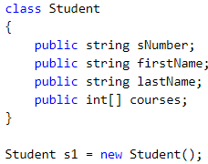
Define Class
Instantiate s1
Legend:
BLUE = Variable Names
RED = Variable Values
sNumber
firstName
lastName
courses
s1

Slide 4
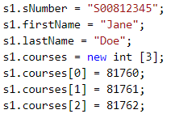
Define Class
Instantiate s1
Populate s1
Legend:
BLUE = Variable Names
RED = Variable Values
sNumber
S00812345
firstName
Jane
lastName
Doe
courses
81760
81761
81762
s1

Slide 5
Define Class
Instantiate s1
Populate s1
Instantiate s2
Legend:
BLUE = Variable Names
RED = Variable Values
sNumber
S00812345
firstName
Jane
lastName
Doe
courses
81760
81761
81762
s1
s2
sNumber
firstName
lastName
courses

Slide 6
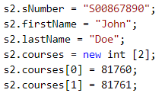
Define Class
Instantiate s1
Populate s1
Instantiate s2
Populate s2
Legend:
BLUE = Variable Names
RED = Variable Values
sNumber
S00812345
firstName
Jane
lastName
Doe
courses
81760
81761
81762
s1
s2
sNumber
S00867890
firstName
John
lastName
Doe
courses
81760
81761

Slide 7
Define Class
Instantiate s1
Populate s1
Instantiate s2
Populate s2
Assign mostBusy to s1
Legend:
BLUE = Variable Names
RED = Variable Values
sNumber
S00812345
firstName
Jane
lastName
Doe
courses
81760
81761
81762
s1
mostBusy
s2
sNumber
S00867890
firstName
John
lastName
Doe
courses
81760
81761

Slide 8
Define Class
Instantiate s1
Populate s1
Instantiate s2
Populate s2
Assign mostBusy to s1
Assign s1 to null
Legend:
BLUE = Variable Names
RED = Variable Values
sNumber
S00812345
firstName
Jane
lastName
Doe
courses
81760
81761
81762
s1
mostBusy
s2
sNumber
S00867890
firstName
John
lastName
Doe
courses
81760
81761

Slide 9
Define Class
Instantiate s1
Populate s1
Instantiate s2
Populate s2
Assign mostBusy to s1
Assign s1 to null
Assign mostBusy to null
Legend:
BLUE = Variable Names
RED = Variable Values
sNumber
S00812345
firstName
Jane
lastName
Doe
courses
81760
81761
81762
s1
mostBusy
s2
sNumber
S00867890
firstName
John
lastName
Doe
courses
81760
81761

Slide 10
Define Class
Instantiate s1
Populate s1
Instantiate s2
Populate s2
Assign mostBusy to s1
Assign s1 to null
Assign mostBusy to null
First Object has 0 References
It’s Destroyed by the GC
Second Object Remains
Legend:
BLUE = Variable Names
RED = Variable Values
s1
mostBusy
s2
sNumber
S00867890
firstName
John
lastName
Doe
courses
81760
81761

